Slide 1
Bob and Anna Lou Schaberg Foundation
Older Adults and Aging

Slide 2


Notes:
The Bob and Anna Lou Schaberg Foundation is a private, family foundation serving the Richmond region. The Schaberg Foundation’s roots are in affordable housing and homeless services. In 2019, we began to understand the impact of the intersection between our housing systems work and the aging population. For example, as our community was successfully reducing homelessness year over year, those over the age of 55 was the only demographic group that was growing each year.
The population of elders needing assistance is growing rapidly, and that growth is expected to continue, with the population of Richmond-area residents aged 65 and older projected to increase by 55,000 – almost 30% -- in the next two decades. As the pandemic made clear, a significant proportion of these elders likely will be lower-income people of color who have faced inequities across a number of social determinants of health for generations and therefore have been impacted by disparate income, housing, and health outcomes.
We reached out to our colleagues at the Richmond Memorial Health Foundation. Together we sought to gain a better understanding of what our community needs to ensure older adults, especially those with low and moderate incomes, can enjoy a good quality of life with the opportunity to age in the home and community of their choice.

Slide 3
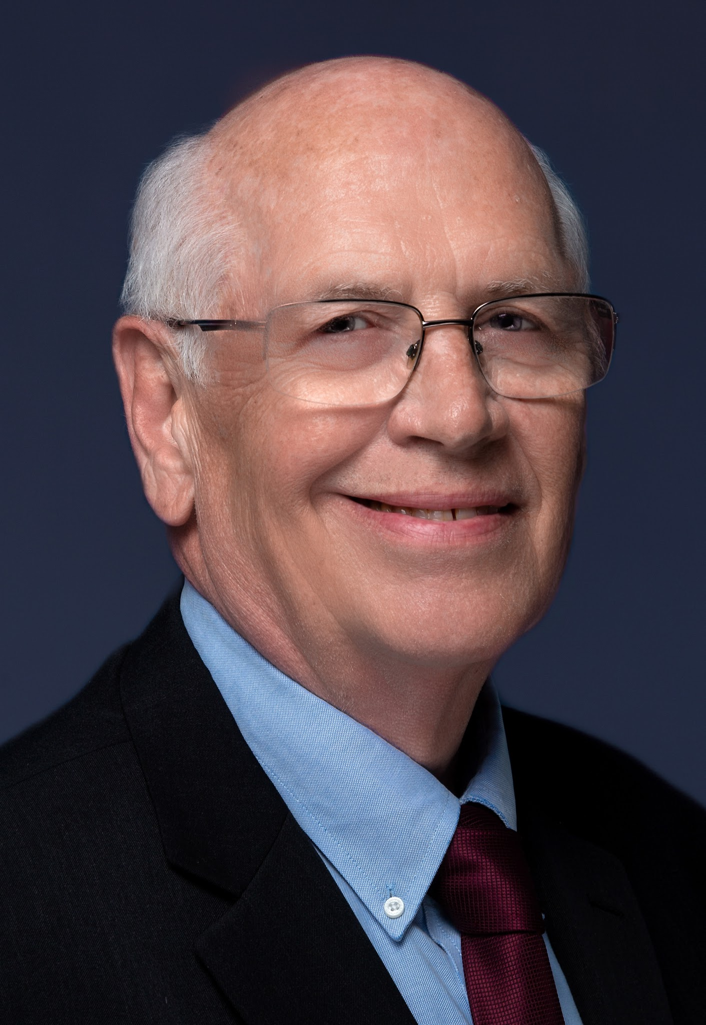
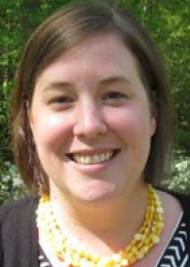
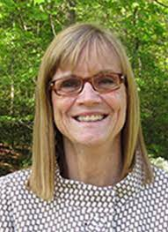
Understanding the Issue
Better Housing Coalition
Community Foundation for a greater Richmond
Circle Center
Virginia Department of Aging and Rehabilitative Services (DARS)
Enterprise Community Partners
Family Lifeline
Jewish Family Services
Longevity Project
Project Homes
Senior Connections
South Richmond Adult Day Care Center
VCU School of Gerontology
VCU School of Nursing
Fred Karnas, Susan Hallett and Susan Brown Davis learn with and from leaders of organizations serving older adult in the Richmond region
Notes:
Because the pandemic was especially hard on the older adults in the Richmond region, there was an urgent need to understand the landscape of older adults services and determine how private philanthropy could be most impactful with our limited resources.
We worked together to learn more. RMHF and the Schaberg Foundation, joined by the Herndon Foundation, convened a series of virtual meetings of nonprofit providers of services to older adults. Through those gatherings, we began to get a glimpse of the depth of the challenges facing older adults, especially those with low and moderate incomes, as well as the challenges faced by the health care and human services sectors charged with supporting them.

Slide 4

Report: Supporting Those Who Support Our Elders
“But low hourly wages combined with a high rate of part-time work result in national median annual earnings for direct care workers of $20,200. Nationally, direct care workers are predominantly female (86%), people of color (59%) and Immigrants (26%). Half of these workers have no more than a high school education.”
Notes:
We supplemented our convenings with several bodies of research, including a report commissioned by RMHF focused on the homecare workforce.
There are not enough in-home caregivers, and the problem is exacerbated by strict limits on Medicaid eligibility that leave many middle-income elders with no support. In addition, there is a need to develop measures to ensure caregivers are well-trained, adequately resourced (compensation, benefits), and supported with transportation options, and technology.
Most elders who require assistance live in the community, (only 4.5% of older adults nationally live in nursing homes and another 2% live in assisted living facilities7 ) which means the assistance generally must come to them.
Virginia will need more than 10,000 additional home/personal care aides each year this decade.
Despite their importance to the system, the status and value of the direct care workforce remain low, frustrating efforts to recruit and retain new workers.
For this workforce, low pay, limited benefits, high stress, physically demanding work and lack of professional training and career development result in high turnover and make recruiting difficult.
As the demographics make clear, the direct-care workforce is disproportionately composed of women of color. Many see this as the legacy of social structures that historically defined “care work” as “women’s work” and, moreover, as the work of those who face discrimination for race, ethnicity or other factors.

Slide 5




OLDER ADULTS & AGING
Advancing the Home Care Profession
Coordination of Aging Services
Policy and Advocacy
Housing Options for Older Adults
Notes:
Through the convenings, interviews and mapping exercise, a number of opportunities to meet the needs of older adults in the Richmond region were identified.
Advancing the home care profession is one part of a four pronged strategy that the Schaberg Foundation and RMHF are engaged in:
Advancing the Home Care Profession
Coordination of Aging Services
Policy and Advocacy
Housing Options for Older Adults

Slide 6
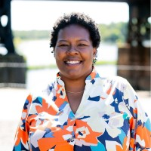
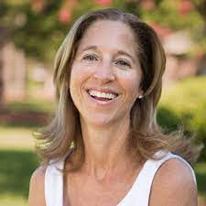

Advancing the Home Care Profession
Demonstration effort focusing on income security for direct care workers, using an asset and wealth building frame
Katina Williams
President & CEO, Family Lifeline
Wendy Kreuter
CEO, Jewish Family Services
Robyn Stone, PhD
Senior Vice President, Research and Co-Director, LeadingAge
Notes:
RMHF and the Schaberg Foundation made a three year commitment to a demonstration project to elevate the home care profession.
This demonstration project is collaboration with two strong nonprofit partners – Family Lifeline and Jewish Family Services – with a long history of providing in-home care to low-income elders. This project is an opportunity to test a series of strategies (based on research and community input) to elevate the homecare profession.
Recognizing that private philanthropy is not in a position to sustain the needed changes to the home care profession, we hope that by implementing these interventions on a smaller scale, we can demonstrate the impact of these changes and use these learnings to influence public policy.

Slide 7

Evaluation
The goal of the evaluation is to assess the overall impact of the intervention on the direct care professionals and the DCPs’ perceptions of the program and the importance of each component.
Program Components:
Increased wages for the direct care professionals
Transportation subsidies
Training that supplements the current in-service training provided
Notes:
The number one priority is to pay care providers a living wage. The other primary goals are to improve training and continued education opportunities, and to create a sustainable and reliable transportation solution for providers with limited access to personal vehicles
We are also working to increase the technological capacity of the organizations to improve communication, efficiency, and data tracking
We have partnered with LeadingAge, specifically the Long Term Supports and Services (or LTSS) Center, which works to create a bridge among the policy, practice and research communities to advance the development of high quality services.
LeadingAge supported the design of the demonstration project and created an evaluation plan with Family Lifeline and Jewish Family Services. They will also help us think about how to advance what we learn from the project as it pertains to policy change.

Slide 8
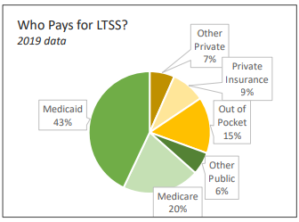
Policy Implications
LeadingAge reported that raising the pay of direct care workers to the living wage in their respective state would yield an impressive return: fewer staffing shortages, lower turnover, higher productivity, robust economic growth and financial well-being for the workers. Local economies would expand as direct care workers increased their spending and depended less on government assistance to make ends meet.
The key to increasing wages for direct care workers is increasing the Medicaid reimbursement rates for their services.
Notes:
Medicaid, the primary payer for LTSS, is funded through general tax revenues, not universal payroll contributions, as is Medicare. So, Medicaid funding at the state level must compete with other funding needs (transportation and education, for example). Private payers constitute a minority of the payment sources for LTSS; private insurance is expensive and few individuals can afford to pay the costs for home or institutional care out of pocket.
The current reimbursement rate is $17.22/hour, which compares to an actual cost of care at $27.88/hour
If we can demonstrate locally that increased wages for direct care workers results in a stronger pipeline of workers, better retention and improved consistency and quality of care (measured by client satisfaction and delayed institutionalization) this is data that can be shared with policy makers.
We also have a chance to explore other policy implications, such as opportunities to standardize training requirements for home care providers and addressing the benefits cliff.

Slide 9

Field Scan: Philanthropy and Older Adults in Virginia
22 funders of all different types from across Virginia were interviewed.
The report will provide an overview of the types of activities being funded by Virginia philanthropy to support older adults:
Services to support aging in place or community
Access to Information, Education, and Learning
Research and Data Collection
Convening
Advocacy
Systems Development and Systems Change
The report is being accompanied by a series of webinars on the older adult issues and the roles philanthropy can play – next webinar: August 23, 2023.
Notes:
At the fall VFN conference, the issue of the challenges facing Virginia’s older adults was raised by keynote speaker Dr. Qian Tsai of UVA’s Weldon Cooper Center
Conference attendees acknowledged the need for philanthropy to step up, but conceded that they knew very little about the older adult work in which funders in the commonwealth were engaged.
VFN with the support of the Richmond Memorial Health Foundation and the Bob and Anna Lou Schaberg Foundation commissioned a scan of older adult work in the Commonwealth.
Twenty-two funders of all different types from across Virginia were interviewed.
Later this spring, the report, tentatively entitled Philanthropy and Older Adults in Virginia, will be made available to VFN members. The report is being accompanied by a series of webinars on the older adult issues and the roles philanthropy can play
The report will provide and overview of the types of activities being funded by Virginia philanthropy to support older adults including,
Services to support aging in place or community(e.g. In-home care, home repair, housing, transportation, adult day services)
Access to Information, Education, and Learning
Research and Data Collection
Convening
Advocacy
Systems Development and Systems Change
The report will also include reflections by current funders regarding how philanthropic responses to the needs of older adults may need to change to address historic inequities, emerging needs, and the challenge of partnering to attain adequate scale.

