Slide 1
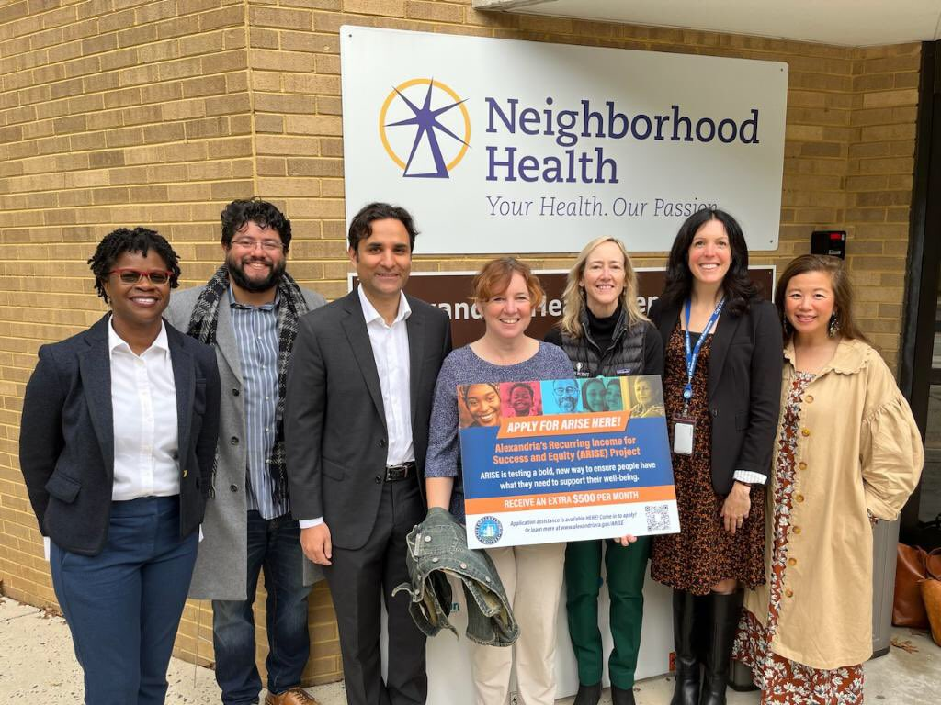
ACT for Alexandria
Reimagining the Safety Net
Partnering with City of Alexandria local government
Administering CARES Act and American Rescue Plan Act funding
Funding Advocacy and Outreach Grants
Piloting Safety Net Programs - ALX Grocery Gift Card Program and ARISE Guaranteed Income Pilot
Supporting Service Navigation and Emergency Support Systems Change Work

Slide 2

About ARISE – Guaranteed Income Pilot
Alexandria’s Recurring Income for Success and Equity Project
$3M program funded through ARPA, appropriated by Alexandria City Council
170 households receiving $500/month for 24 months – no strings attached (4,149 completed applications)
City of Alexandria residents – 18 years or older, household income at or below 50% AMI
Benefit waivers for TANF, SNAP, Medicaid, Low Income Housing Energy Assistance Program, and Childcare Subsidy (no waivers for HUD housing subsidies or SSA for SSI)
Access to supportive services and coaching
Research and evaluation and RCT conducted by Abt Associates

Slide 3
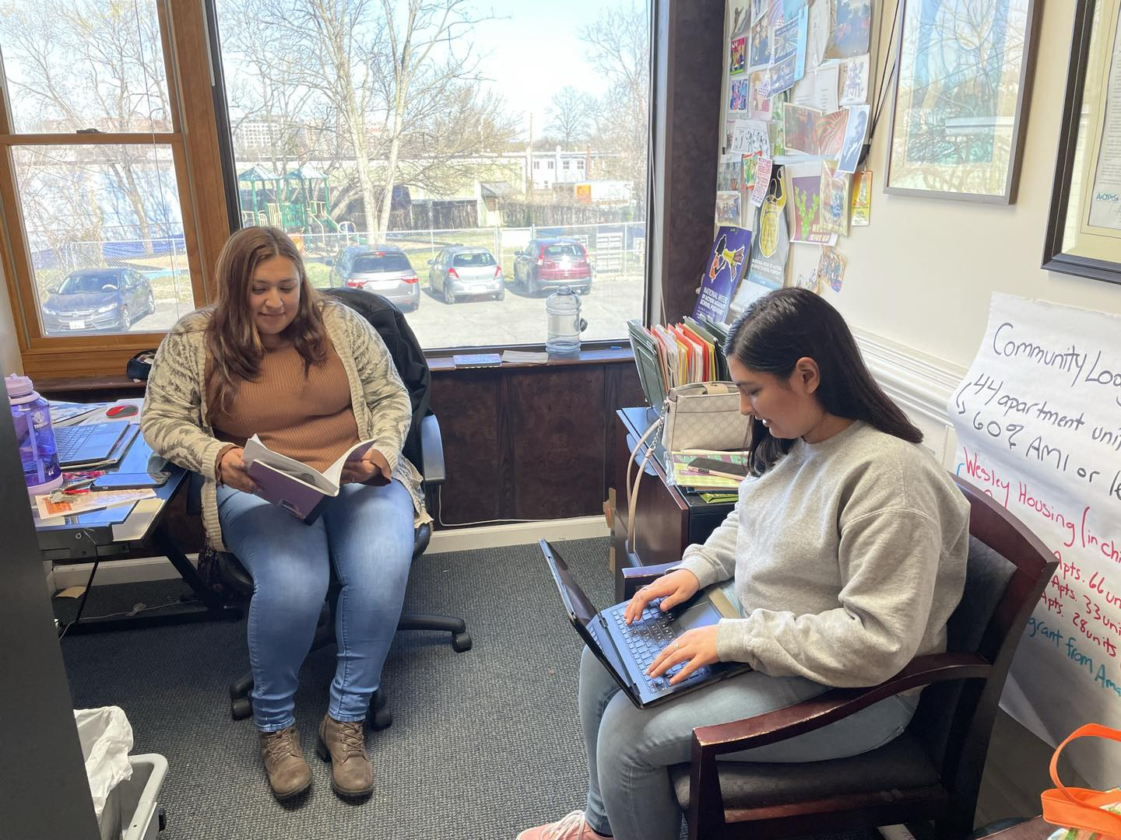

ACT’s Role in Supporting ARISE
Advocacy, Strategic Communications
Pre-Pilot
  Promoting advocacy through mini grants
Phase One
  Developing a strategic communications plan
  Centering community voice and perspectives
  Creating a multi-lingual communication toolkit
  Awarding outreach grants to nonprofit partners
Phase Two
  Storytelling and sharing impact
  Building public will and case for funding post-pilot

